Slide 1
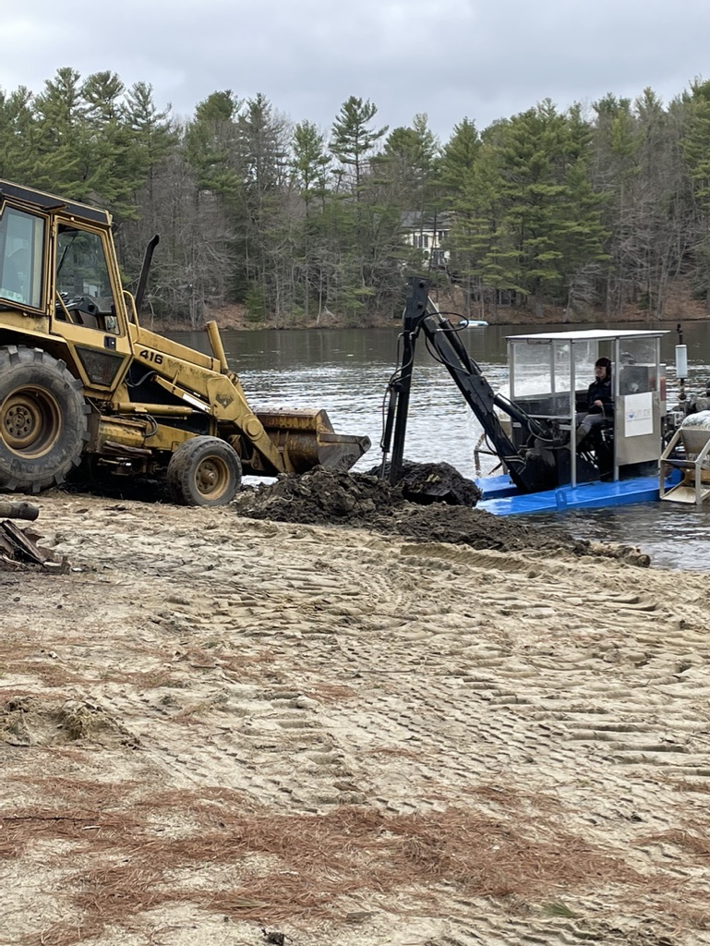
2022 Wachusett Shores and PPOA Annual Meeting
Sunday May 15, 2022
1:00 At the PPOA Lodge

Slide 2
Agenda
Welcome
Thanks to all who help keep the Association running
Minutes of 2021 PPOA Annual Meeting
Treasurer’s Report
Old Business
New Business
Vote and set the 2023-2024 Annual Membership and Deed Assessment Fee
Elections
Q&A
Adjournment

Slide 3
Thanks Volunteers!
Thank you to all of our neighbors who have volunteered to help PPOA throughout the year. It’s your neighborhood, and you help keep it running!

Slide 4
Minutes of May 2021 Annual Meeting

Slide 5
Treasurer’s Report

Slide 6
TOTAL NET WORTH as of 3/31/2022
Real Estate (Lodge and Land) | $300,938.75
Investment portfolio | $249,751.44
Cash | $33,255.31
Total assets | $583,945.50
Total liability | $0
Net worth | $583,945.50

Slide 7
Investment Portfolio

Slide 8
Payments History (FY'2016 - FY'2022)

Slide 9
Edward Jones Asset Allocation
Total Portfolio as of March 31, 2022

Slide 10
FY 2021-2022 Expenses
EXPENSES | BUDGET | ACTUAL | VARIANCE
Town Real Estate Taxes | $ 2,270.87 | $ 1,356.77 | $ 914.10
United Site Services (Porta Potti) | $ 1,200.00 | $ 1,429.64 | $ (229.64)
Charter Communications | $ 3,000.00 | $ 3,159.05 | $ (159.05)
National Grid (Electric) | $ 700.00 | $ 1,142.22 | $ (442.22)
Trash (E.L. Harvey and Sons & Republic) | $ 500.00 | $ 564.70 | $ (64.70)
Security Alarm Systems | $ 216.00 | $ 216.00 | $ -
USPS (Stamps) | $ 200.00 | $ - | $ 200.00
Broberg Insurance (Liability & Lodge) | $ 6,153.96 | $ 6,153.96 | $ -
Huhtula Oil (Fuel) | $ 2,000.00 | $ 1,668.49 | $ 331.51
Dept of Revenue Taxes | $ 100.00 | $ - | $ 100.00
US Dept of Rev /State of Mass/Annual report | $ 80.00 | $ - | $ 80.00
PO Box Annual Renewal | $ 64.00 | $ 64.00 | $ -
E.coli Test (Nashoba Analytical) & Variance Survey | $ 900.00 | $ 795.00 | $ 105.00
Web Site Hosting Renewal | $ 150.00 | $ 171.05 | $ (21.05)
Lodge inspection: Town of Hubbardston | $ 40.00 | $ - | $ 40.00
Leins/LegalFees | $ 1,000.00 | $ - | $ 1,000.00
Tax Accountant | $ 750.00 | $ 775.00 | $ (25.00)
Mailings/Meetings/Supplies | $ 300.00 | $ 10.00 | $ 290.00
Spring Cleanup/Annual Beach Party | $ 500.00 | $ 456.25 | $ 43.75
TOTAL OPERATING EXPENSES | $ 20,124.83 | $ 17,962.13 | $ 2,162.70

Slide 11
FY 2021-2022 MAINTENANCE & IMPROVEMENTS
 | PLAN | ACTUAL YTD | VARIANCE
Lodge cleaning & supplies | $ 200.00 | $ 31.47 | $ 168.53
General Repairs & Maintenance | $ 2,000.00 | $ 475.80 | $ 1,524.20
Fuel / Supplies for Mowing, etc. | $ 100.00 | $ 40.00 | $ 60.00
Pond Maintenance (Solitude Lake Management) | $ 30,000.00 | $ 5,264.12 | $ 24,735.88
TOT. MAINTENANCE & IMPROVEMENTS | $ 32,300.00 | $ 5,811.39 | $ 26,488.61

Slide 12
FY 2021-2022 INCOME
INCOME | PLAN | ACTUAL YTD | VARIANCE
FY 2020 Maint Fees (Plan: 186 x $200) | $ 37,200.00 | $ 21,533.00 | $ (15,667.00)
Past Due Maint Fees / Interest | $ 39,684.00 | $ - | $ (39,684.00)
Lodge Rentals | $ 500.00 | $ 400.00 | $ (100.00)
Interest (GFA Checking) | $ 2.00 | $ 6.92 | $ 4.92
Interest (GFA Savings) | $ 5.00 | $ 2.36 | $ (2.64)
Other (Misc) | $ 150.00 | $ - | $ (150.00)
Dock Fees | $ 200.00 | $ 200.00 | $-
TOTAL INCOME | $ 77,741.00 | $ 22,142.28 | $ (55,598.72)

Slide 13
Operating Budget

Slide 14
Accounts as of March 31, 2022
ACCOUNT | BALANCE | PORTFOLIO TOTAL
GFA Checking | $30,013.08*
GFA Savings | $3,242.23 | $33,255.31
Edward Jones Investments | $249,751.44 | $249,751.44
Total |  | $283,006.75
* $30,000 was removed last year from Edward Jones in anticipation of the pond project cost.

Slide 15
Old Business
Beach vandalism
Lodge Well
Pond Maintenance

Slide 16
New Business
Cushman Pond eutrophication abatement strategy
Spring Cleanup May 21 and June 11
Lock and turn over your boat
Beach water testing
Goose abatement and trail Maintenance
Friendship Fireplace
Trash at the Lodge
Summer Beach Barbeque & Games
Multi-media for Lodge

Slide 17
FY 2022-2023 Budget Proposal

Slide 18
PROPOSED FY2022-23 BUDGET
EXPENSES | BUDGET |  | INCOME | BUDGET
Town Real Estate Taxes | $ 2,300.00 |  | Maint Fees (Plan: 174 x $200) | $ 34,800.00
United Site Services (Porta Potti) | $ 1,450.00 |  | Past Due Maint Fees / Interest | $ 52,790.00
Charter Communications | $ 3,200.00 |  | Lodge Rentals | $ 500.00
National Grid (Electric) | $ 1,000.00 |  | Interest (GFA Checking) | $ 7.00
Trash (E.L. Harvey and Sons & Republic) | $ 575.00 |  | Interest (GFA Savings) | $ 2.50
Security Alarm Systems | $ 216.00 |  | Dock Fees | $ 150.00
USPS (Stamps) | $ 200.00 |  | TOTAL INCOME | $ 88,249.50
Broberg Insurance (Liability & Lodge) | $ 6,267.32
Huhtula Oil (Fuel) | $ 1,800.00
US Dept of Rev /State of Mass/Annual report | $ 80.00 |  | TOTAL EXPENSES | $ 46,522.32
PO Box Annual Renewal | $ 64.00
E.coli Test (Nashoba Analytical) | $ 280.00 |  | TOTAL INCOME | $ 88,249.50
Web Site Hosting Renewal | $ 175.00 |  | OTHER INCOME | $
Lodge inspection: Town of Hubbardston | $ 40.00
Tax Accountant | $ 775.00 |  | NET CASH FLOW | $ 41,727.18
Mailings/Meeting Supplies | $ 300.00
Spring Cleanup/Annual Beach Party | $ 500.00
TOTAL OPERATING EXPENSES | $ 19,222.32
MAINTENANCE & IMPROVEMENTS | BUDGET
Lodge cleaning & supplies | $ 200.00
General Repairs & Maintenance | $ 2,000.00
Fuel / Supplies for Mowing, etc. | $ 100.00
Pond Maintenance (Solitude Lake Management) | $ 25,000.00
TOT. MAINTENANCE & IMPROVEMENTS | $ 27,300.00
TOTAL EXPENSES | $ 46,522.32

Slide 19
Voting
2023-2024 Annual Maintenance and Deed Assessment Fee
PPOA Board of Directors

Slide 20
Vote For PPOA Board Of Directors
President: Bill Homans (Expires 2023)
Treasurer: Gail Orciuch
Clerk: Dennis Majikas (Exp. 2023) / Jim Ellis Assistant
Directors:
Josh Adams (Exp. 2022) Dave Blad (Exp. 2023) Bob Brooks (Exp. 2023)
John Day (Exp. 2023) Jeanne Carter (Exp. 2022) Lee Carter (Exp. 2022)
Bill Poudrier (Exp. 2023)
Associate: Jim Ellis
Webmaster: Brendon Toupense
Volunteers are always needed and much appreciated.

Slide 21
Q & A

Slide 22
Thank You

